Slide 1
Early Childhood for Special Learners
Working with Children with Exceptionalities in an Early Childhood Setting

Slide 2
Introductions
Who I am.
What I am not.
What I wish I was. (And, maybe one day I WILL be!)
Tell me about YOU!!!

Slide 3
Let’s just get this out of the way…
Etiquette says that when we discuss a person who has a disability, we should always put the person first, then name the disability if it is applicable to the situation.
So, when we are talking about a child who is on the autism spectrum, we should say “child with autism”, instead of autistic child.
BUT…

Slide 4
In the Real World,
I will try to be careful and considerate about how I refer to ANY person, regardless of age. But I will slip and say “autistic kid” and I just want you to know that my heart is for these children even if I don’t sound totally PC.
Sometimes, talking about challenges such as disabilities puts us in a position where we are either going to have to laugh- or we are going to have to cry.

Slide 5
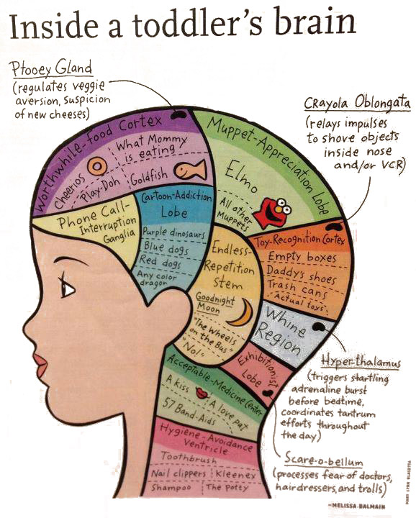

Slide 6
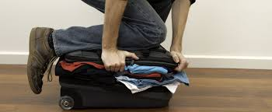
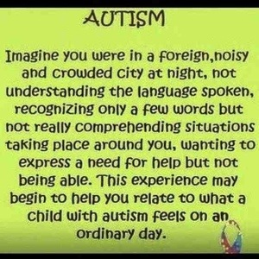
Let’s go on a trip to…
Close your eyes and try to imagine.

Slide 7
Autism facts from the cdc
Autism (ASD) is a lifelong disorder that currently affects 1 out of every 68 young children. Boys are 5 times more likely to be diagnosed than girls.
It is a complex array of behavioral, communication, sensory and cognitive differences that make it difficult for the child to understand and process their environment.
The symptoms can range from extremely mild to severe, so it is called a “spectrum” disorder.
Symptoms are generally present long before the age of 3, though some children aren’t identified until later.
There are probably several causes for autism, which is what makes it hard to “cure”. We do know that genetics plays a factor. Vaccines are not likely to be responsible.

Slide 8
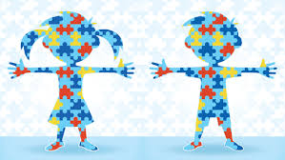
Puzzle people
Children with ASD generally do not have an unusual physical appearance. However, their behavior, speech, responses to other people or to events in their environment generally set them apart. Some examples:
The adorable cherub who gags whenever a green food is put on his plate. He may gag, hit the nearest person, then stand up and throw his chair.
The little girl who spins in circles whenever she walks through a doorway or right before she sits in a chair. She flaps her hands when she is excited and sings, but does not talk.
The little boy who screams louder and longer than any human being you’ve ever heard because he doesn’t like the sound of the toilet flushing.
The little boy who licks people and only eats potato chips and cheese crackers for every single meal.
The beautiful little girl who never wears shoes and sits criss-cross-applesauce all day long while she rocks back and forth with her eyes closed.

Slide 9
There is hope
Children with ASD have strengths and talents just like any other child.
More people with autism are growing up to live productive, fulfilling lives. They can become authors, college professors, inventors, entrepreneurs…
With the right support and intervention, many children with ASD will become verbal individuals who attend regular classes in school, graduate from high school, and find suitable employment.

Slide 10
Why you need to know
Early intervention is critical. Your role as one of the first caregivers of a child with ASD means that YOU may be the one who notices the symptoms, starts a much-needed conversation with a parent, or who points them to CHILDFIND.
YOU are INVALUABLE. Your experience working with many children at the same developmental stage allows you to see delays or exceptions to normal child development that an inexperienced or unknowledgeable parent may not have noticed. Here are some things to look for.

Slide 11
A few Possible Red Flags
Doesn’t respond to their name by 12 months
Doesn’t wave bye-bye, clap in excitement, or interact with caregivers by 12 months
Doesn’t point to objects of interest by 14 months (airplanes, animals, etc.)
Doesn’t pretend play by 18 months (feeding a doll or copying grownup behavior)
Avoids eye contact
Has a “flat affect” in facial expressions and/or voice (generally expressionless)
Prefers to be alone
Doesn’t speak, or
Exhibits speech delays or doesn’t seem to understand what is said to them
Uses objects atypically (spinning wheels on an upside-down car, lining up blocks)

Slide 12
A few Possible Red Flags
Seems overly sensitive OR undersensitive to senses (smells, sounds, textures, etc.)
Doesn’t seem afraid of anything, or is afraid of everything
Gets upset easily
Has obsessive interests
Echoes sounds or words excessively
Seems “stuck” in a pattern of behavior such as flapping, spinning or rocking
Doesn’t like changes to routine
Tantrums frequently “for no apparent reason”
Sensory seeking behaviors such as banging, crashing, climbing
A motor that is stuck in high gear

Slide 13
Dangers to be aware of
Chidren with ASD do not understand what is and is not dangerous. They are more likely to be the victim of:
Drowning (one of the main causes of death in children with ASD)
Poisoning
Being hit by cars or being ejected during an accident due to dislike of seatbelts
Falling from great heights
Being bitten/injured by animals
Getting lost- they usually can’t tell an adult who they are when asked, they often avoid people (hide), and they have no understanding of dangers such as traffic, water, chemicals, electricity, heights, etc.)
Abduction
Sexual abuse
Bullying

Slide 14
They just don’t understand
Children with ASD come up with their own “rules” because those rules are the way that they make sense of their world. This is where the belief that they are “stubborn” comes from.
The first way that they experience something, even a new word that they hear, is the way they expect it to be done from that point on. That is their UNDERSTANDING of the new thing.
Children with ASD often “relive” the first experience, like a movie, every time they see/hear something similar.
-The first dog they meet may be sweet and let them pull their tail all day. The second dog may bite them in the face. They don’t understand that there are different types of dogs. To them, all dogs are exactly the same.
-The first time they hear the song “Happy Birthday to You” may have been overwhelming. Now they freak out whenever they heard the tune- even in the greeting card section of Wal-Mart.
-The first time they drank apple juice, they threw up because of an unrelated stomach virus. Now, apple juice makes them gag if they see or smell it.
WITH TIME, EXPOSURE TO DIFFERENT EXPERIENCES, AND SUPPORT, THIS CAN CHANGE FOR MANY CHILDREN.

Slide 15
Stressors (triggers) for children with asd
Children with ASD often have difficulty with things that their peers do not. This leads to stress that they may not have the ability to communicate or to cope with on their own, such as
Passage of TIME (WHEN something will happen, waiting)
Fear (not understanding their world)
The inability to filter out environmental stressors such as buzzing, temperature, wetness, texture, smells, or the itch of a bug bite
An unmet need such as a wet diaper, illness, fear, or an unanswered question
A change in routine (holidays, being picked up by a different parent, a fire drill, etc.) or just a change from what they are currently enjoying (transition)
Inability to do something that they want to be able to do, like COMMUNICATE!
Proprioceptive/vestibular confusion (where their body is in relation to the world)

Slide 16
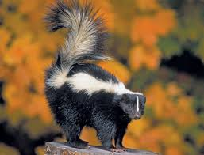
Tantrums vs. meltdowns
A tantrum is a choice. The child is in control of their behavior and is trying to control a situation or tell you something. They can stop the tantrum any time they want to.
If a child stops screaming the minute that they get what they want, it’s a tantrum.
The most common causes of a tantrum are control-seeking or attention-seeking (or both). Find your patience! This is a teachable moment.
A meltdown is when a child has lost control of their ability to start or stop a behavior. It is usually a response to fear, pain, or overstimulation. Imagine if you couldn’t stop a painful feeling from bombarding you constantly. Eventually, you would just “lose it”.
If there is NO apparent reason for the behavior and the child’s wants and needs have been met, and they are still screaming, it’s a meltdown. Find your compassion!

Slide 17
Tantrum strategies
Stay calm.
Keep them safe and other children safe too!
Stay silent. They can’t hear you anyway.
Avoid direct eye contact.
Scan for stressors, including on the child’s body. Remove stressors if you can.
Physiological changes are amazing at helping them to reset.
Ignore it if they just want attention, but be sure that this is the function of their behavior.
Try not to touch them unless it’s a comfort. It usually isn’t!
WHEN THEY ARE CALM, teach them a better way.

Slide 18
Meltdown strategies
Handled mostly like tantrums, except please don’t ignore them.
Physiological changes can be very helpful.
Sometimes all you can do is keep them safe until they get it out of their system.
When they are receptive, comfort them. Meltdowns are traumatic for them. Imagine if you lost control of your body for a while.
With both tantrums and meltdowns, ABC data is very helpful in preventing more in the future.

Slide 19
Abc data
Antecedent- what happens right before- what the kid or other people did
Behavior- what the kid did
Consequence- what happened immediately after the behavior- what the kid did, what other people did, etc. A consequence is just an effect- it is not necessarily a punishment! Often, it’s an unintentional reward (like when the adult gives in).
Use any written system that makes sense to you where you record specific information about what happens before, during and immediately after a tantrum or meltdown. You will be able to look back and see patterns.
Look for patterns- 5W’s are very helpful
Change the A’s and C’s to find a better way!

Slide 20
Smokescreens
Any sight, sound, smell or sensory experience that helps to drown out an unwanted experience. Kids already do this!
Sights- something they enjoy, darkness
Sounds- music, singing, white noise
Smells- something they enjoy
Movement- swinging, rocking, clapping

Slide 21
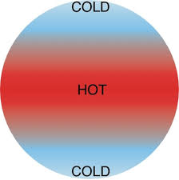
Physiological changes
When a child melts down, they are not able to control themselves. They need to reset but don’t know how. You may be able to help.
Physiological changes, RESETS, are a change to the current physical state of the child so that they can find themselves.
Temperature, changing body position and light are the most effective. Sometimes sound works too.
Washing hands, turning out the lights, ice packs, cold drink, etc.

Slide 22
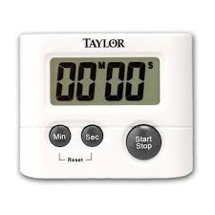
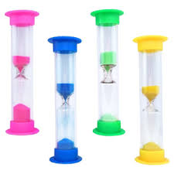
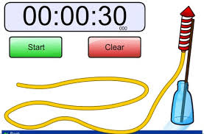
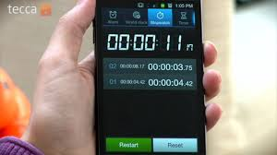
Time strategies
Visual timers- let them see how much time is left
Be careful about alarm sounds, pair it with something good to avoid upsetting them
Visual schedules
First/Then statements (FIRST we slide, THEN we swing!)
Structure and routine are critical!!! But build in some flexibility!!!

Slide 23
Why even good changes cause meltdowns
Children with ASD struggle constantly to make sense of their world. Just when they think they’ve figured something out, somebody goes and changes it on them!
Parties are fun, right?
What if a party with lots of kids, loud noises, movement, presents, colorful decorations and a creepy clown is just more than you can figure out? What would you do? You’d escape or you would “lose it” (meltdown).
OR
What if your father, who you adore, got off of work early and decided to pick you up from daycare. You always ride home with Mommy. In your mind, NOT getting to ride in Mommy’s car after naptime means that you will never get to go home again. Tantrum/meltdown time!

Slide 24
Change strategies- transition
Transition: the shift from one activity to another
Use visual aids, especially schedules, to show the child what’s happening next
Music and movement is a great way to take the focus off of the change while it is happening- dance to the next activity or sing a song about sitting at the table while you walk there.
Keep one thing the same- a transition object can help
Keep activities age-appropriate in length- short! Always leave them wanting more.
Plan the order of activities ahead of time. If you know they won’t like something, like diaper-changing, then plan a favorite activity for right after it. Show them the visual schedule, and use First/Then statements. “FIRST, change diaper, THEN painting!”

Slide 25
Sensory seeking/Proprioceptive strategies
Small amount of weight (a rice-filled sock on a child’s lap or around their shoulders)
Small amounts of pressure (gently squeezing the sides of their face, shoulder massages
Sensory diet (find out what the child wants and provide a more appropriate way of experiencing it) such as a water table, jumping, swinging, rocking chair, etc.)
Physiological Changes- more in a minute
Heavy work (carrying a heavy object over a short distance, like a heavy book or a chair), pushing against the wall, etc.
Use visual barriers so kids know where they should be- duct tape on floor, color coding chairs and placemats, furniture placement, etc.

Slide 26
Fear strategies
Structure and routine
Safe exposure over time to a fearful thing- done with love and sensitivity, following the child’s lead
Learning the sensory likes of the child
“Smoke screens”
Redirection
Escape, but done correctly
***Warning a child in order to “prepare” them for something scary that will happen later can backfire and cause anxiety, so know the child’s personality. Are they a prepper? Many parents overuse prepping and make things worse. Smokescreens usually work better than prepping does.

Slide 27
Communication Strategies
Sign language
Pointing- you may have to teach them
Songs and music
Photos ———> Pictures———>Symbols
PECS- Picture Exchange Communication System (requires some training, but very useful!)
iPad apps
ALL TANTRUMS ARE BEHAVIOR. Usually the behavior is related to the inability to communicate. What are they trying to tell you?
Speak to them using simple words with clear directions. Grammar is not your focus. It’s okay to cut out “extra words” until their language expands. (Some experts disagree with this.) Instead of “It’s time to go to the potty” say “Potty time!” or “Time go potty!” in a pleasant voice.

Slide 28
Following the child’s lead
If you want to get into their world, follow them. They can’t show you the way, but they often enjoy the companionship.
Get on their level. This is often the floor for young children. Don’t push eye contact right away.
Do what they are doing. Noises, hand motions, etc.
Wait for brief eye contact. It’s a sure sign of their interest!
Take turns, but don’t snatch things from them. Take it gently if they’ll let you and repeat their behavior. Show them you like it too, but don’t be “too much”.
Play SHORT turn-taking or cooperative games. Row, Rown Your Boat, Ring Around the Rosies, Peek-a-Boo, AAAAACHOOOOOOO!!!!!
Be playful and positive.
LEAVE THEM WANTING MORE. Stop while it’s still fun for them.

Slide 29
What to do if you are concerned
For any age, advise the parent to call their pediatrician. Taking a developmental checklist with them (with notes about their child) is helpful.
For children under the age of 3, parents should also call:
For children 3 and older, the parent should contact the local public school system.
Catherine Hancock, Part C Coordinator
Infant and Toddler Connection of VA
Dept. of Behavioral Health and Developmental Services
Phone: (804) 663-7270
Fax: (804) 371-7959
Email: catherine.hancock@dbhds.virginia.gov
Website: http://www.infantva.org/
ReferPhone: (800) 234-1448
ReferWebsite: http://www.infantva.org

Slide 30
To contact me
Stacy White
Early Childhood Special Education Teacher at Appomattox Primary School
Email me @
slwhite@acpsweb.com
Check out my teacher blog @
www.exceptionalprek.weebly.com

